Slide 1

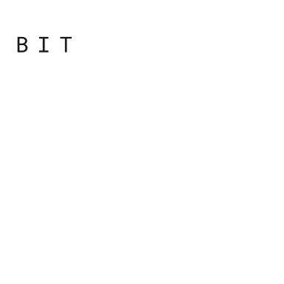
Programming
Principles
with JavaScript

Slide 2

Overview
JavaScript. History. Lexical Structure
Types, Values and Variables
Numbers and strings

Slide 3
Types, Values and Variables

Slide 4
Values and Types
Computer programs work by manipulating values, such as the number 3.14 or the text “Hello World”
Values that can be represented and manipulated in a programming language are known as (data) types

Slide 5
Values and Types
One of characteristics of a programming language is the set of types it supports
When a program needs to retain a value for future use, it assigns the value to a variable.

Slide 6
Variables
Variables are used to store data
They are placeholders for concrete values
When writing programs, it's convenient to use variables instead of the actual data
pi instead of 3.14159265358979

Slide 7
Variables
Variable defines a symbolic name for a value and allows the value to be referred to by name
Data stored in a variable can be changed after it was initially assigned, hence the name variable

Slide 8
Variables
To declare a variable, you will use the var statement like the following piece of code
var a;
var thisIsAVariable;
var _and_this_too;
var mix12three;

Slide 9
Variables
Using a variable requires two steps:
• Declaring the variable
• Initializing variable, i.e. giving it a value
You can use any combination of letters, numbers, the underscore character, and the dollar sign as a variable name
You can't start a variable name with a number

Slide 10
Operators
Operators denote basic actions we would like to perform. We call operands values (or variables) they work with.

Slide 11
Operators
3 + 4
7
+ is the operator
The operation is addition
The input values are 3 and 4 (also called operands)
The result value is 7
The whole thing is called an expression

Slide 12
Operators
Addition
Subtraction
* Multiplication
/ Division
% Modulo, the remainder of division
++ Increment a value by 1
-- Decrement a value by 1
= Assignment operator
+= -= *= /= %= Compound operators

Slide 13
JavaScript types
Any value that you use is of a certain type.
Primitive types
Object types

Slide 14
Primitive data types
Number - floating point numbers and integers
String - any number of characters
Boolean - 2 values either true or false
Undefined - without value assignment
Null - no value, empty value
Any value that doesn't belong to one of the five primitive types listed here is an object

Slide 15
Finding out the value type
To find out the type of a variable or a value, you use the special typeof operator
returns a string that represents the data type
The return values of using typeof are one of the following:
"number"
"string"
"boolean"
"undefined"
"object"
"function"

Slide 16

Practical
Notes:
Starting with the bootcamp
Hoping to catch the wave and achieve much more

